Slide 1
FACTORY MUTUAL

Slide 2
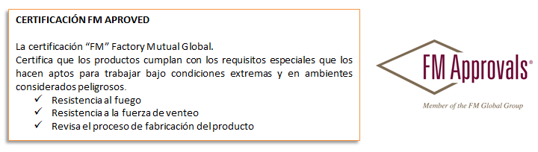
What is the FACTORY MUTUAL CERTIFICATE certification
FM Approvals is an international leader in the field of testing and homologation services carried out by independent entities. We ensure that claims prevention products and services (intended for use in commercial and industrial facilities) meet the requirements of the highest standards in terms of quality, technical integrity and performance
FM's mission is to minimize the possibility of loss of its clients' properties. In addition, it offers certification and testing services for industrial and commercial products from around the world through FM Approvals®. This is recognized and respected worldwide, ensuring that customers receive a product or service that has undergone objective testing and that meets the strictest national and international standards.

Slide 3
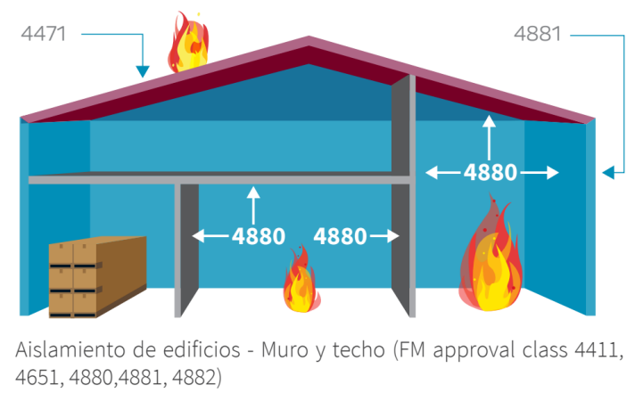
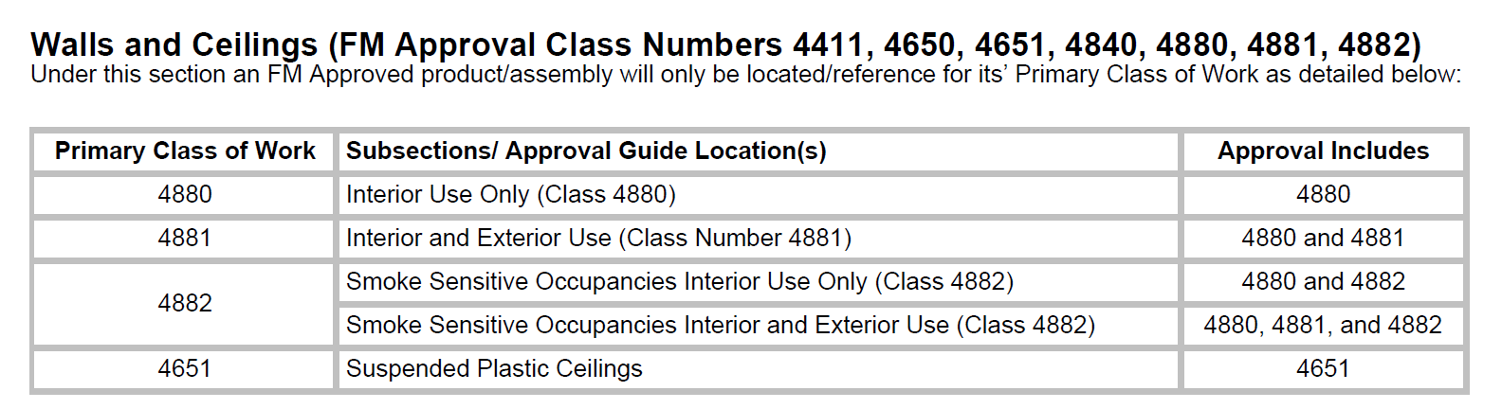
Overview of the FACTORY MUTUAL CERTIFICATE
WALLS AND FALSE SKY
Below are the FM Standards that apply to Installation in Walls and False Sky, which indicate the type of use:
Indoor use,
Outdoor use,
• Smoke-sensitive occupations,
• Suspended ceilings

Slide 4
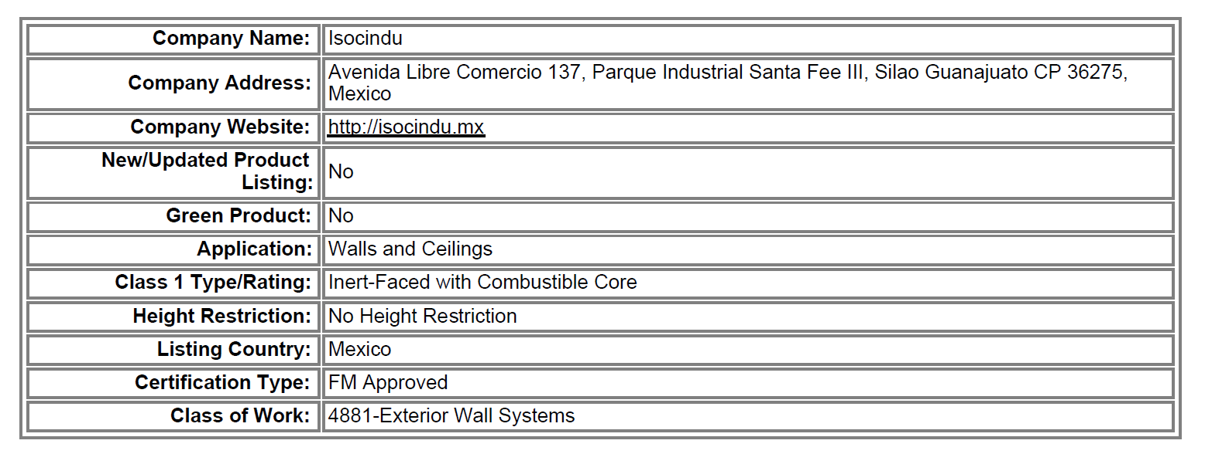
FACTORY MUTUAL ISOCINDU CERTIFICATE
At the bottom of the Certificate, summarize the Classification Obtained:
APPROVED:
FM 4881, includes approvals 4880 and 4881
As the Leaderboard below indicates:

Slide 5
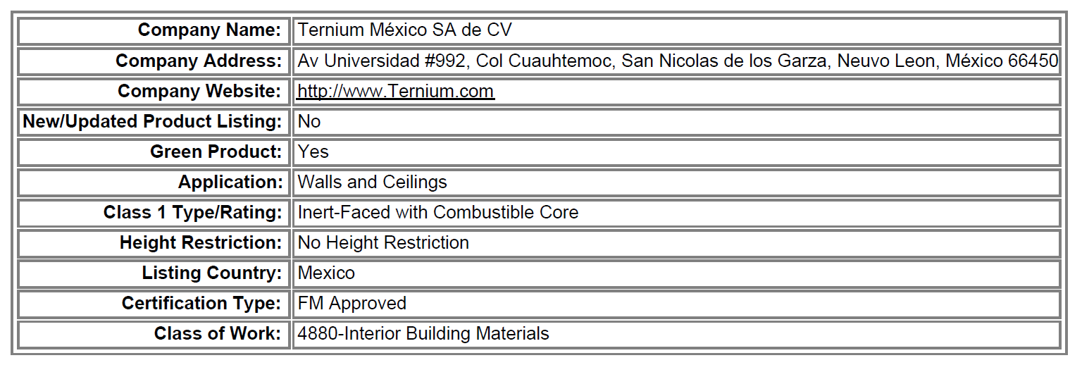
FACTORY MUTUAL ternium CERTIFICATE
At the bottom of the Certificate, summarize the Classification Obtained:
APPROVAL:
FM 4880, Indoor Use Only
As the Leaderboard below indicates:

Slide 6
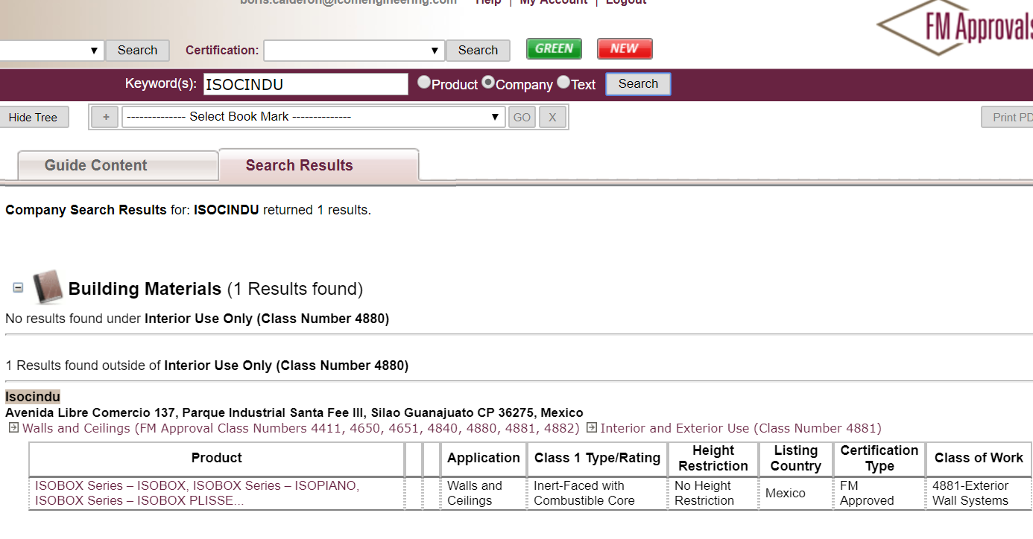
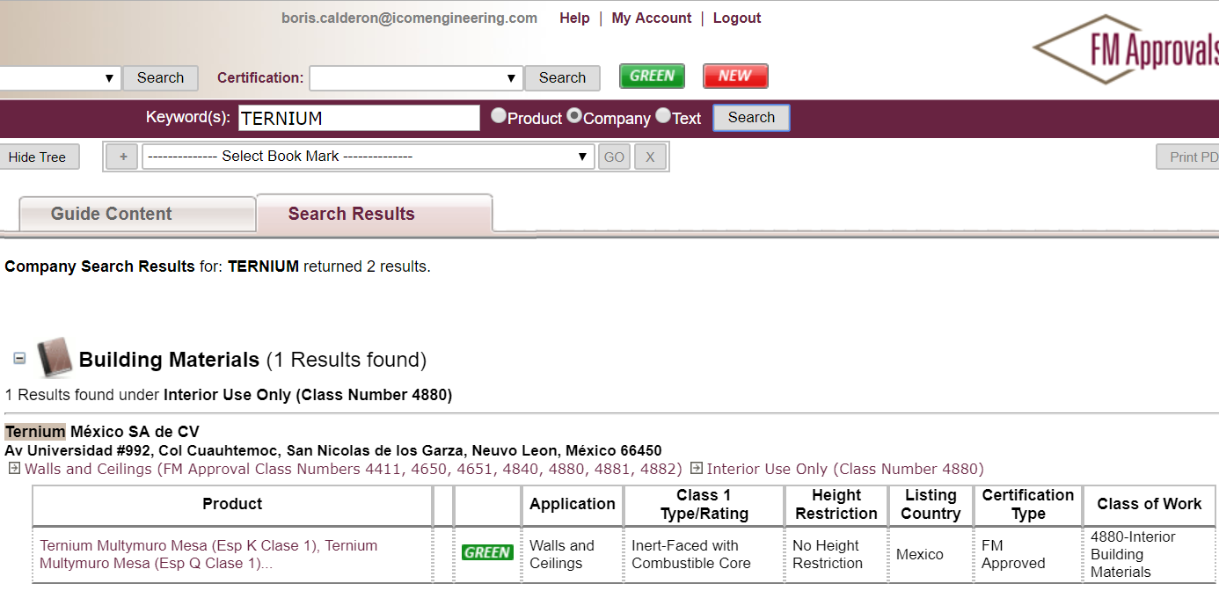
APPROVED ISOCINDU:
FM 4881, includes approvals 4880 and 4881
Information Obtained directly from the FM APPROVALS website, on July 1, 2022
APROBACIÓN TERNIUM:
FM 4880, Uso Interior Únicamente

Slide 7
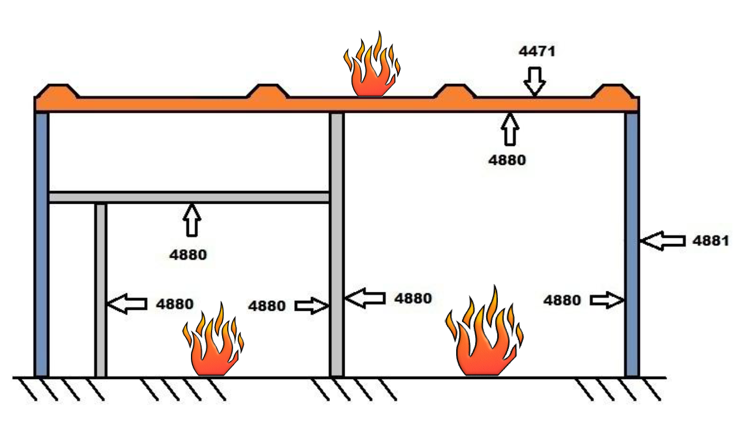
CONCLUSIONS:
As far as walls is concerned, there are important differences in the Factory Mutual Certifications.
1. Isocindu has the FACTORY MUTUAL Certification for both Interior and Exterior Walls and False Sky, that is, FM 4880, FM 4881
2. In the case of Ternium, it only has the FACTORY MUTUAL Certification for the Interior Walls Only, FM 4880
3. Enclosed the Certificates downloaded from the Website

